Slide 1
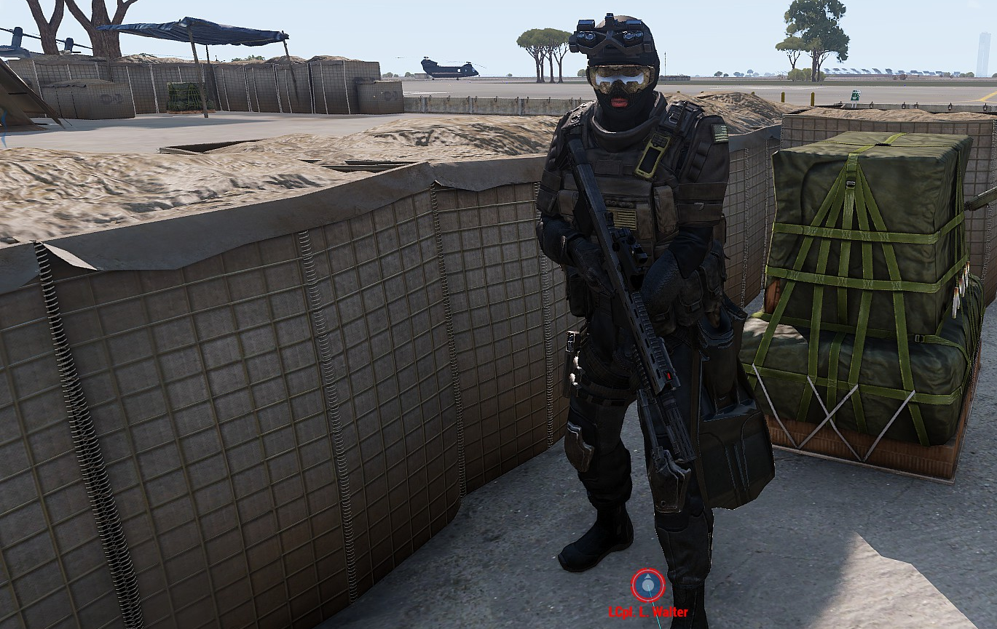
WELCOME TO OPERATION UNFORMAL

Slide 2
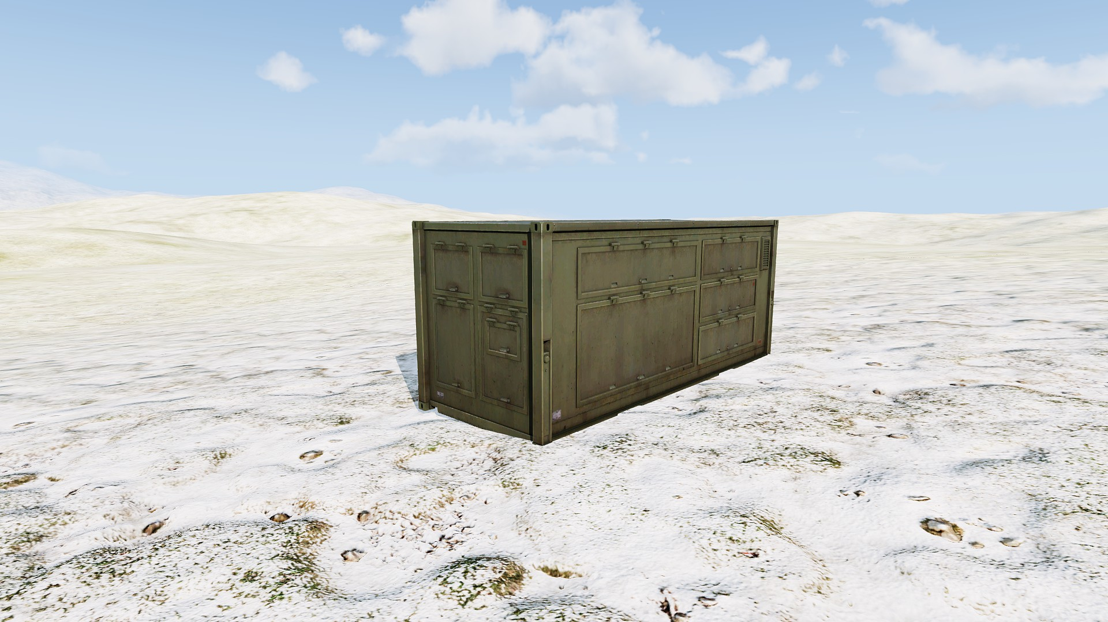
AMMO CRATES LIKE THIS ARE
YOUR NEW LIMITED ARSENAL
THERE ARE ONLY 2. DO NOT LOSE THEM!
PLEASE DO NOT ATTEMPT TO GAIN GEAR FROM THE ARSENAL,
OR BY ANY OTHER MEANS (PA).
HOWEVER, YOU CAN PICK UP ENEMY EQUIPMENT ETC

Slide 3
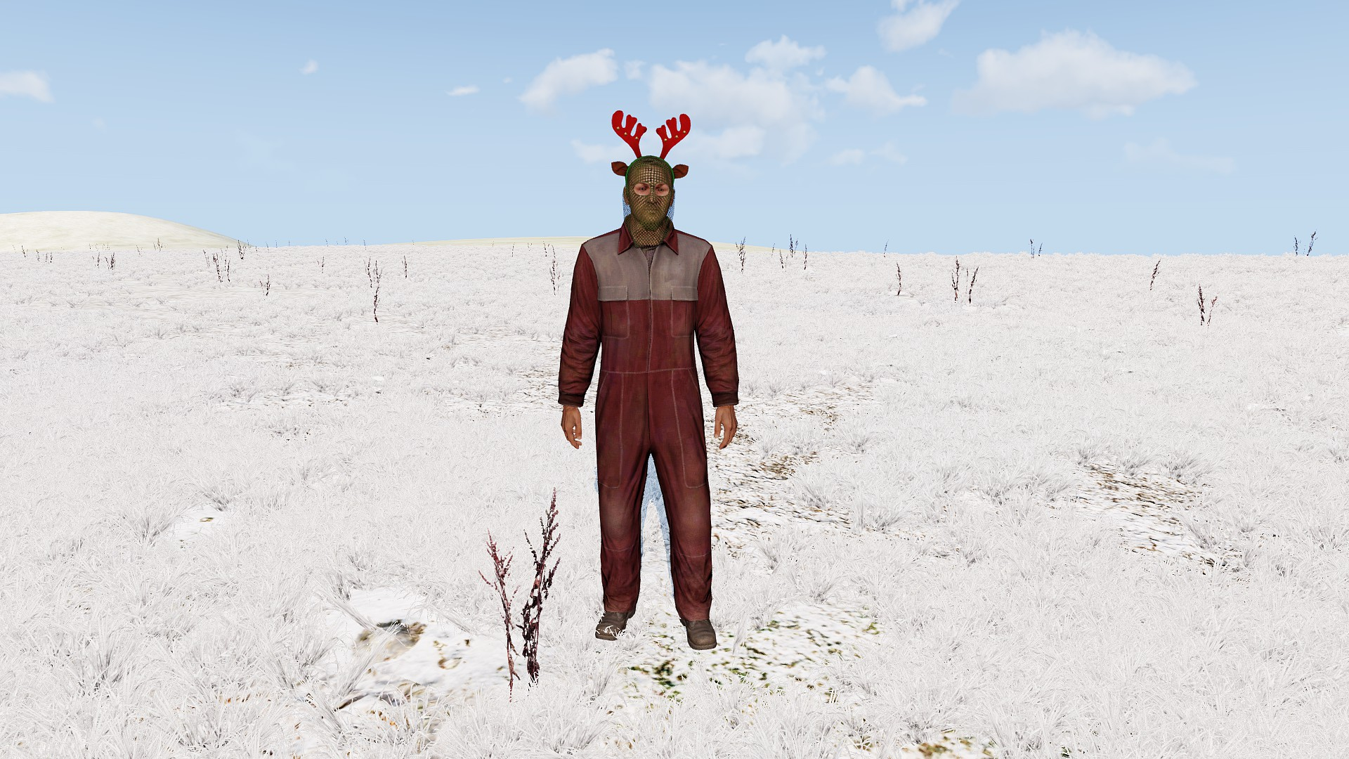
YOUR TASK IS TO FIND AND COLLECT 7 REINDEER.
‘REINDEER’ LOOK LIKE THIS.
PLEASE DO NOT SET THEM FREE!
You can see a rough location of their trackers on the map.

Slide 4
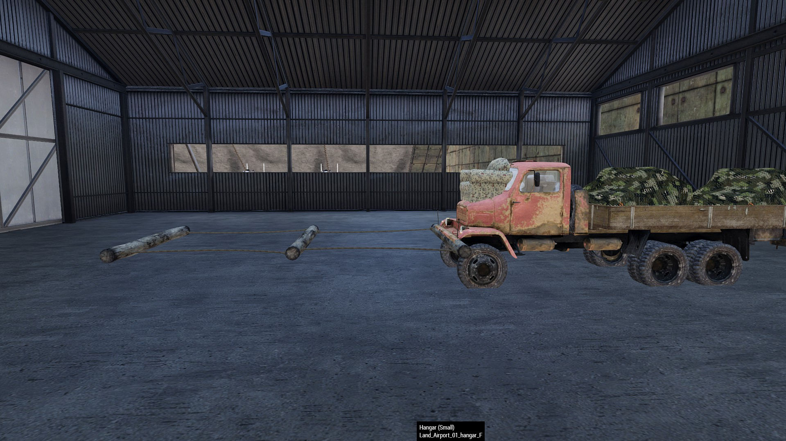
TO COMPLETE YOUR MISSION.
BRING ALL 7 REINDEER BACK TO THE SLEIGH
UN FORCES ARE HERE TO HELP.
DO NOT ATTACK UN FORCES, EVEN FOR THEIR EQUIPMENT.
YOU WOULDN’T WANT TO GET PUT
ON THE NAUGHTY LIST WOULD YOU?

Slide 5
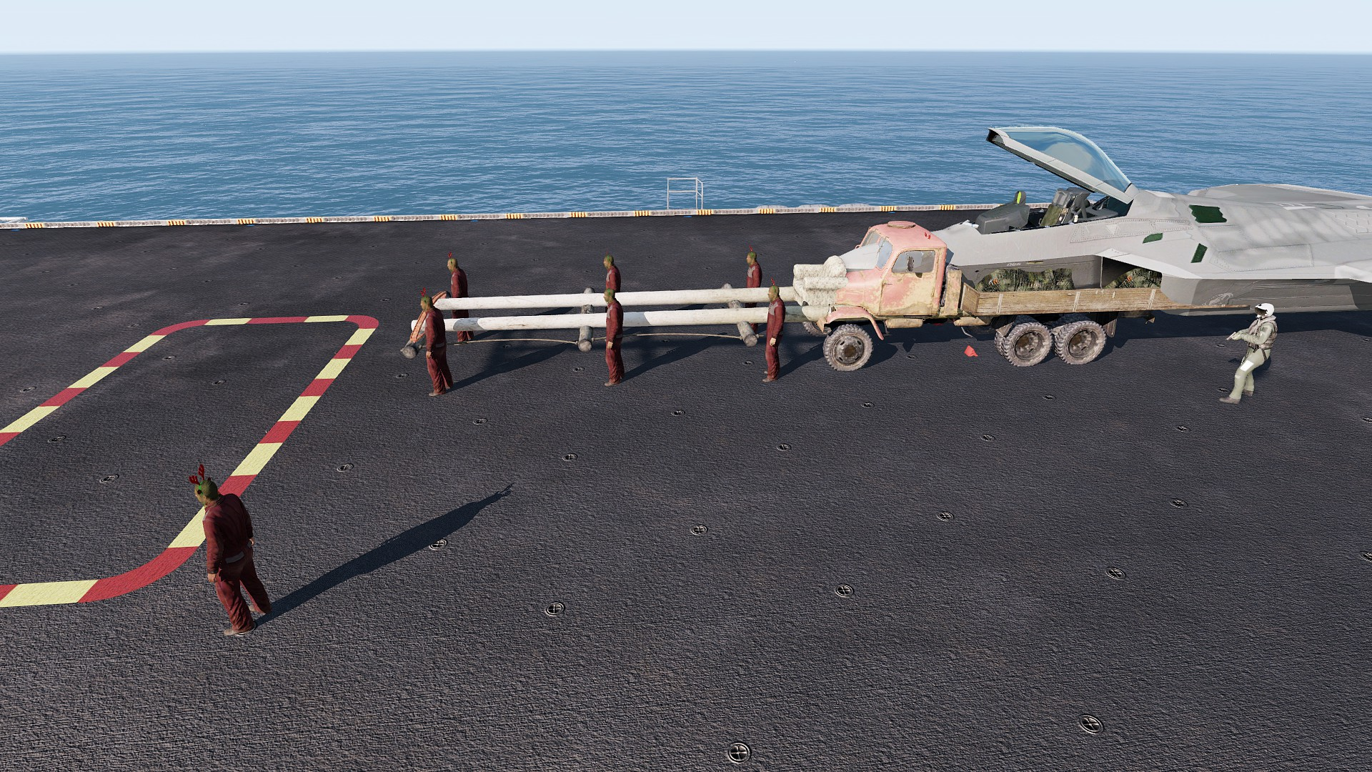
UN MEME TEAM 12
You can organise yourselves into small groups, or a large force it is up to you.
You have 30 mins to ‘barbie’ yourselves.
UN Vehicles, are at your disposal.
Head to EMMG to retrieve special fun vehicles that might help you in your effort!

